Slide 2

Git basic & practices
Bien Hoang ➔ April 2016

Slide 3
agenda
Git Introduction
Git Practices
Branch in Git
Remote Git

Slide 4

about me
Software Engineer at Deha Software
bien@deha-soft.com
bienhoanggiang@gmail.com
Hoàng Giang Biển

Slide 5
agenda
Git Introduction
Git Practices
Branch in Git
Remote Git

Slide 6
version control system types
Centralized Version Control System
Distributed Version Control System

Slide 7
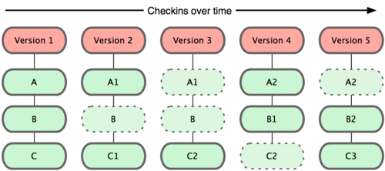
three git traits #1 commits are snapshot
Notes:
A commit contains:
changes at the time it’s created
a pointer to parent commit containing unchanged things
commit ID is a hex string for hashed content

Slide 8
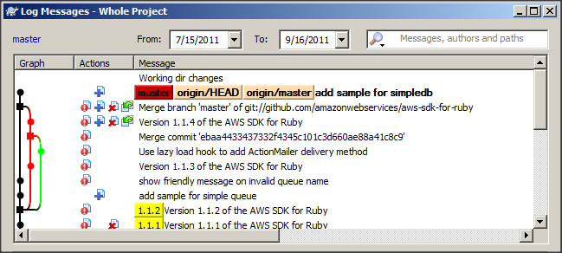
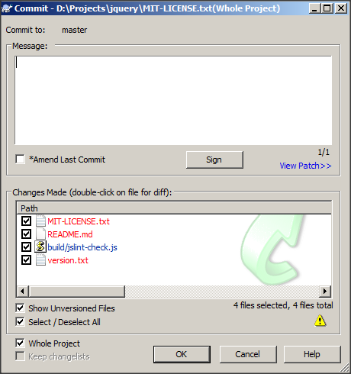
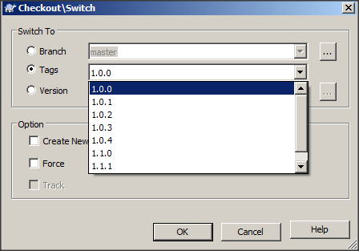
three git traits #2 work without network

Slide 9
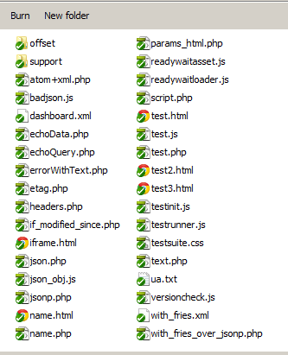


three git traits #3 two states
git add
git rm
etc.
Git Index / Staging
Area
git commit
Working Directory
Git Repository
Notes:
Staging Area ~ temporary storage managed by Git

Slide 10
basic works (demo)
Create new git repository
Work on git staging area
Update git repository
Check status
Undo
Notes:
Go through following commands:
git init
git add, rm, mv
git commit
git commit –amend
git log, status, diff
git reset, checkout (undo + go to commit)

Slide 11
agenda
Git Introduction
Git Practices
Branch in Git
Remote Git

Slide 12
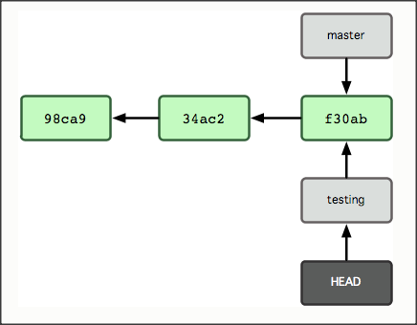
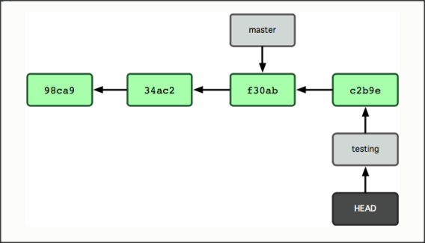
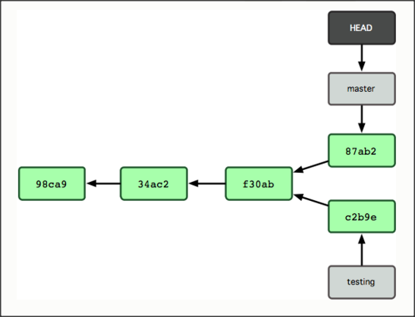
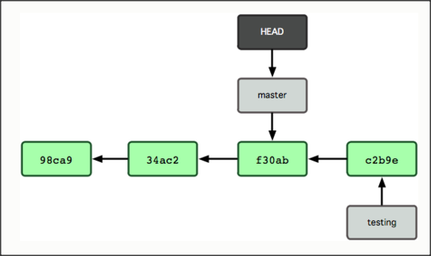
branch and how it works
1
2
4
3
Notes:
Branch ~ pointer to a commit
HEAD ~ alias for latest commit in branch

Slide 13
agenda
Git Introduction
Git Practices
Branch in Git
Remote Git

Slide 14
remote urls
Local | /data/git/project.git
SSH* | user@server:project.git
Git | git://server/project.git
HTTP | http://server/project.git
(*) Setup authentication: https://help.github.com/articles/generating-ssh-keys

Slide 15
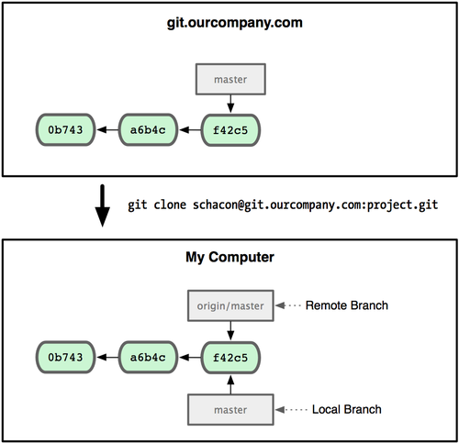
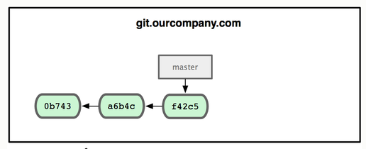
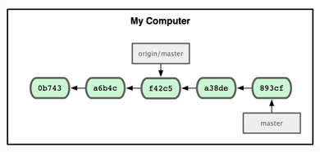
remote branch
Time
Notes:
remote branch is controlled by git fetch + git push
git clone by default creates a master remote branch

Slide 16
remote tracking branch
➔ a local branch associated with remote branch
> git branch --track [branch] [remote name]/[branch]

Slide 17
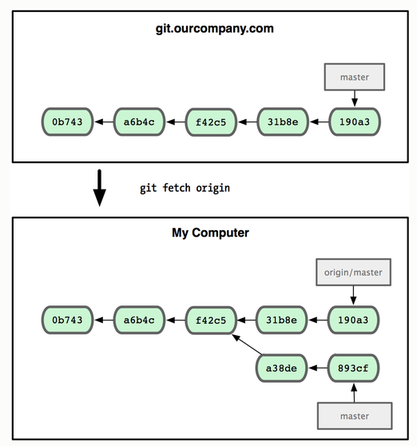
update with remote repository get changes #1
git fetch origin
Time

Slide 18
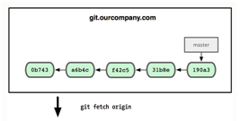
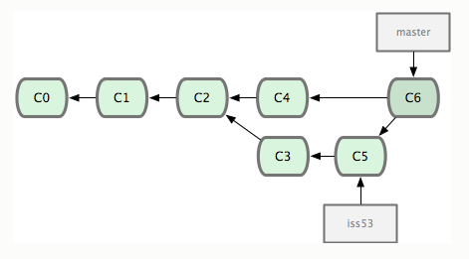
update with remote repository get changes #2
git pull origin
master
origin/master
Time

Slide 19
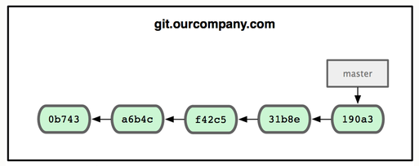
update with remote repository save changes
git.ourcompany.com
master
git push origin
origin/master
master
origin/master
master
Time

Slide 20
basic works (demo)
Create remote git repository
Get new commits from remote repository
Save new commits to remote repository
Notes:
Update configuration to allow pushing: $ git config receive.denyCurrentBranch ignore
git clone
git fetch (+ pull)
git push

Slide 21
agenda
Git Introduction
Git Practices
Branch in Git
Remote Git

Slide 22
highlight of git features (demo)
git tag
git stash
git submodule

Slide 23
git clients
http://git-scm.com: Git CLI (command line interface)
UI clients
TortoiseGit
SmartGit
SourceTree Free
Git Extensions

Slide 24


git or svn ?
 | Git | SVN
Speed of operation | Faster
Data loss | Less
Independent and isolated environment | Yes
Access control |  | Yes
Locking mechanisms |  | Yes
Storage space | 1/30 size
Notes:
speed of operation: commit, viewing history, reverting changes, etc.
data loss: SVN can have corrupted revision database
independent and isolated: Git allows user to work without network connection and keep their work privately
lock mechanims: plays an important role when it comes to non-mergable binary files such as graphic assets
access control: define read/write permission on particular folder, allow to work on particular folder instead of getting entire tree

Slide 25
git best practices
Line - ending issue on platforms
Do not miss any file when committing in conflicted merge
Commit early commit often
Branch early branch often
 | Windows | Mac & Linux
Problem | \r\n | \n
Solution | git config --global core.autocrlf true | git config --global core.autocrlf input
Notes:
Line-ending issue
Windows: convert CRLF to LF when commit, and convert LF to CRLF when checkout to file system
Linux: convert CRLF to LF when commit only
Do not miss: if you miss any file, it means changes in that files from the branch you’re merging will be discarded

Slide 26
THANK YOU

